Slide 1
Project-I on
“ Quiz Game ”
Samir Balami(312923)
Dipsagar Chaudhary(312911)

Slide 2
Background of Project
A Quiz Game is a form of game or mind sport in which players attempt to answer questions correctly about a certain or variety of subjects. Quizzes can be used as a brief assessment in education and similar fields to measure growth in knowledge, abilities or skills.

Slide 3
Objectives
1. To built user friendly quiz game.
2. To improve general knowledge of player.

Slide 4
Features
1.Simple and easy to play.
2. Add questions.
3. Question to modify
4.Score card.

Slide 5
System analysis
Functional requirements: - player enter name: - every student can enter name and access the features of this application. Attempt quiz:-a user should be able to attempt any of the four sections of the quiz and also have the option to skip questions. Check score: - after completing a quiz, the user must be able to check the score of a particular section.
COMPUTERIZED SYSTEM:- The existing system is totally manual thus there are chances of error in processing. The basic and major drawbacks in the existing system are the speed of retrieval of data from files, which leads to delay. Maintenance of voluminous data is very cumbersome and laborious job. The manual jobs such as calculation are more error prone. There are plenty of chances of duplicity of data and information. Updating is very tedious job.

Slide 6
Algorithm
Step-1: Start
Step-2: Display welcome to quiz game. Himalayan Whitehouse College. Enter 1 to start the game. Enter 2 to view the highest score. Enter 3 to add question. Enter 4 for help. Enter 5 to quit.
Step-3: When entered 1. Display enter your name. After entering player name display question along with 4 answer. Player given there answer. If answer is correct than display correct answer and score added. Else display wrong answer. After 10th question display score of player.
Step-4: When entered 2. Display player name and highest score.
Step-5: When entered 3. Add Question.
Step-6: When entered 4. Display game help menu.
Step-7: When entered 5. Then exit the game.
Step-8: Stop

Slide 7
Block Diagram
START
1
2
3
4
5
Qustion and Answer
Highest score
Add question
Help menu
STOP

Slide 8
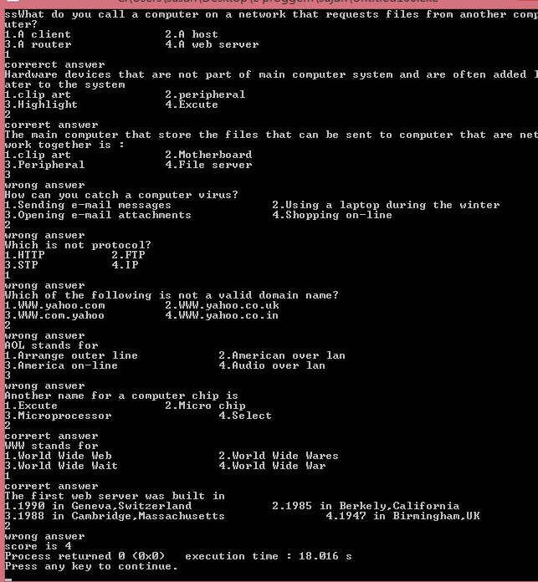
Output

Slide 9
CONCLUSION
The quiz game designed is very interactive, user friendly and easy to play. The
Game allows test his knowledge. The question database can be easily adding the
Question.
Recommendations are more and more games like these should be designed as it improves the knowledge and at the same time test your IQ level. Quiz games should be designed in a more interactive and friendly way so that more people can play, enjoy and at the same time improve, enhance and test their knowledge.

Slide 10


